Slide 1
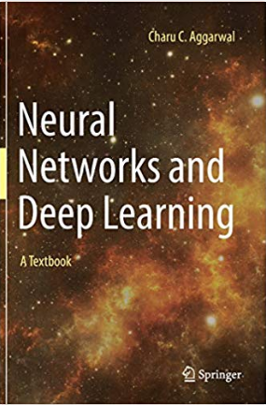
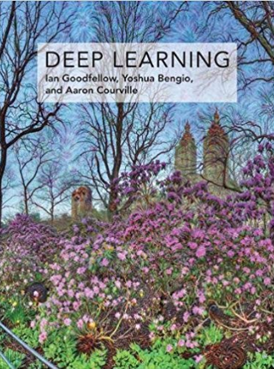
Books
Deep Learning
Publisher: MIT Press
Authors:
Ian Goodfellow
Yoshua Bengio
Aaron Courville
Neural Networks & Deep Learning
Publisher: Springer
Author:
Charu Aggarwal

Slide 2
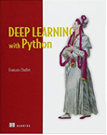
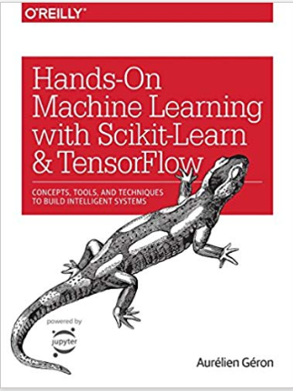
Books: TensorFlow
1 | Deep Learning with Python By Francois Chollet
2 | Hands-On Machine Learning with Scikit-Learn & TensorFlow By Aurelien Geron

